Slide 1

Recommendation System

Slide 2
Agenda
Recommendation Engine
How We Prepared Our Data
Data Cleaning
Algorithms We Used (methods)
Results & Analysis

Slide 3
Recommendation Engine
Recommendation engines are a way of modeling and rearranging information available about subscriber preferences and then using this information to provide informed recommendations on the basis of that information.
Recommender systems help the subscribers to get personalized recommendations, helps users to take correct decisions in their online transactions, increase sales and redefine the users web browsing experience, retain the customers, enhance their shopping experience.

Slide 4
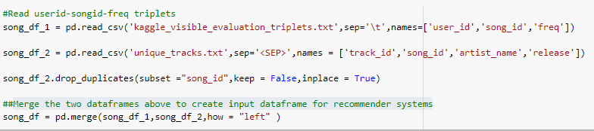
How we prepare our Data
Read the user_id, song_id, freq from the triplet data set and track_id, song_id, artist_name, release from unique_tracks data set
Drop Duplicates from unique tracks data set
Merge the two dataframes above to create input data-frame for recommender systems

Slide 5
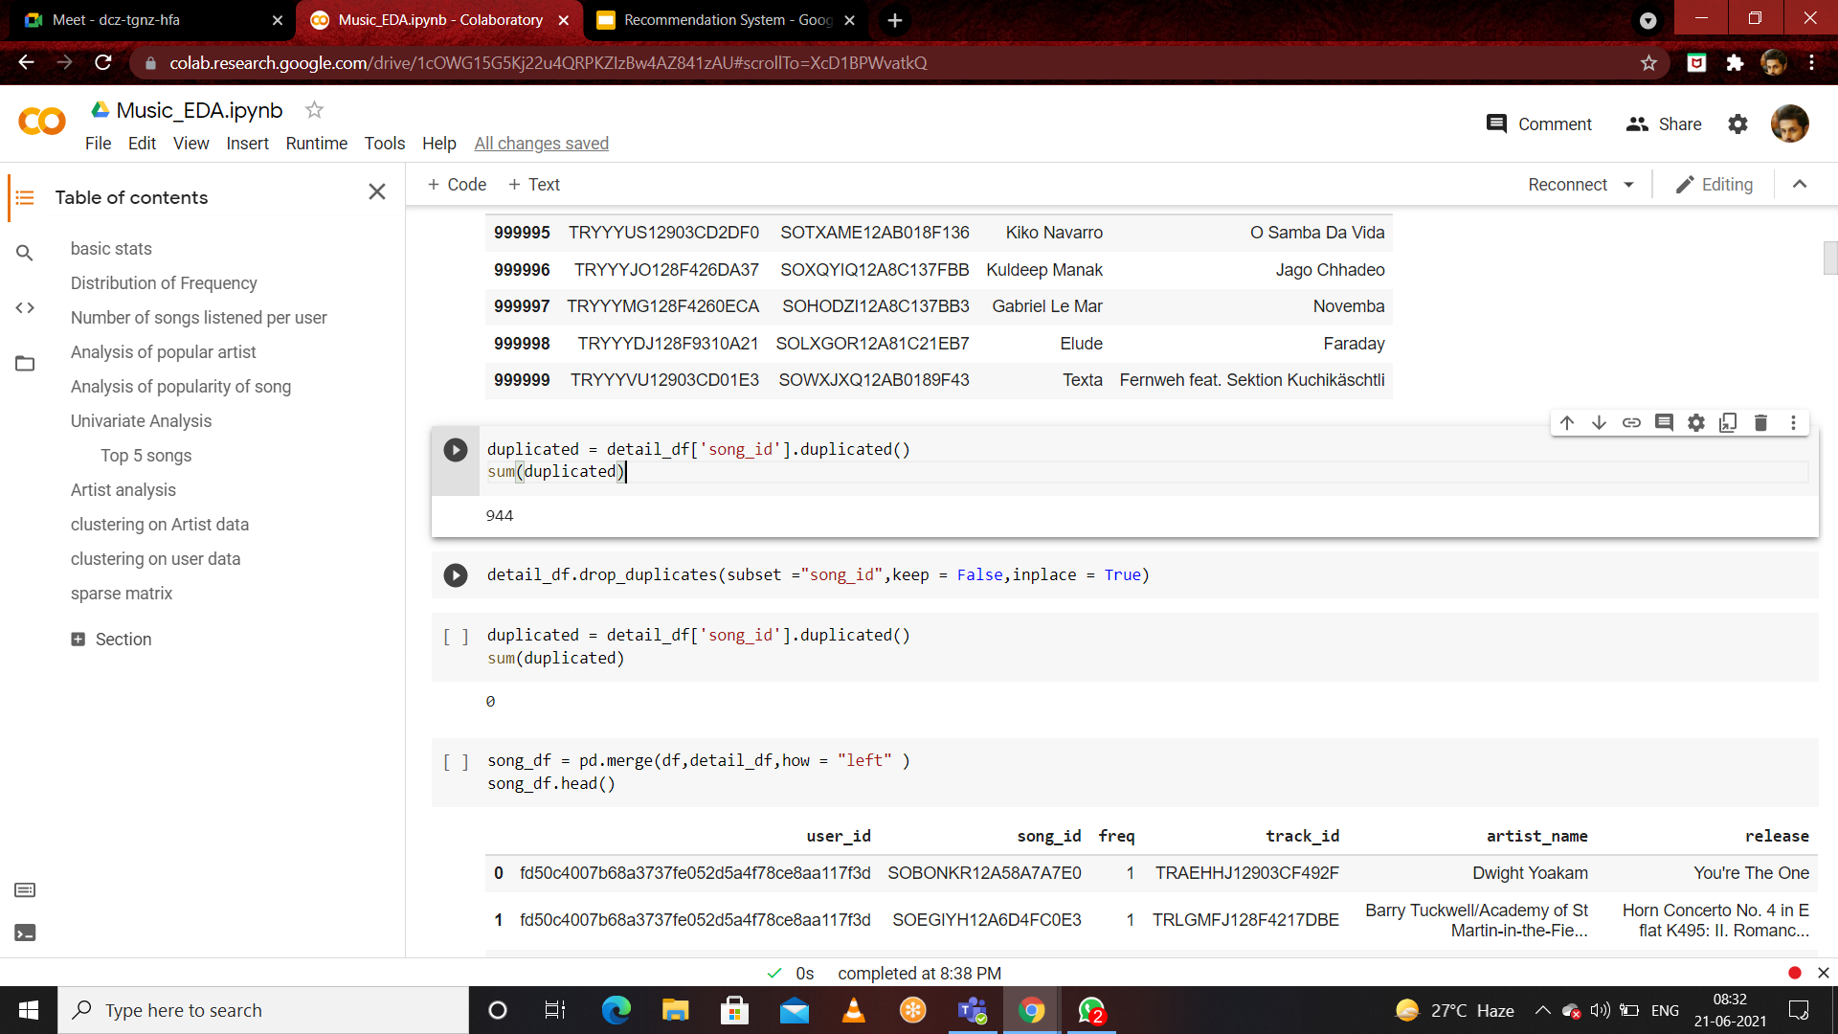
Data Cleaning
The process of converting or mapping data from the initial “raw” form into another format, in order to prepare the data for future analysis .

Slide 6
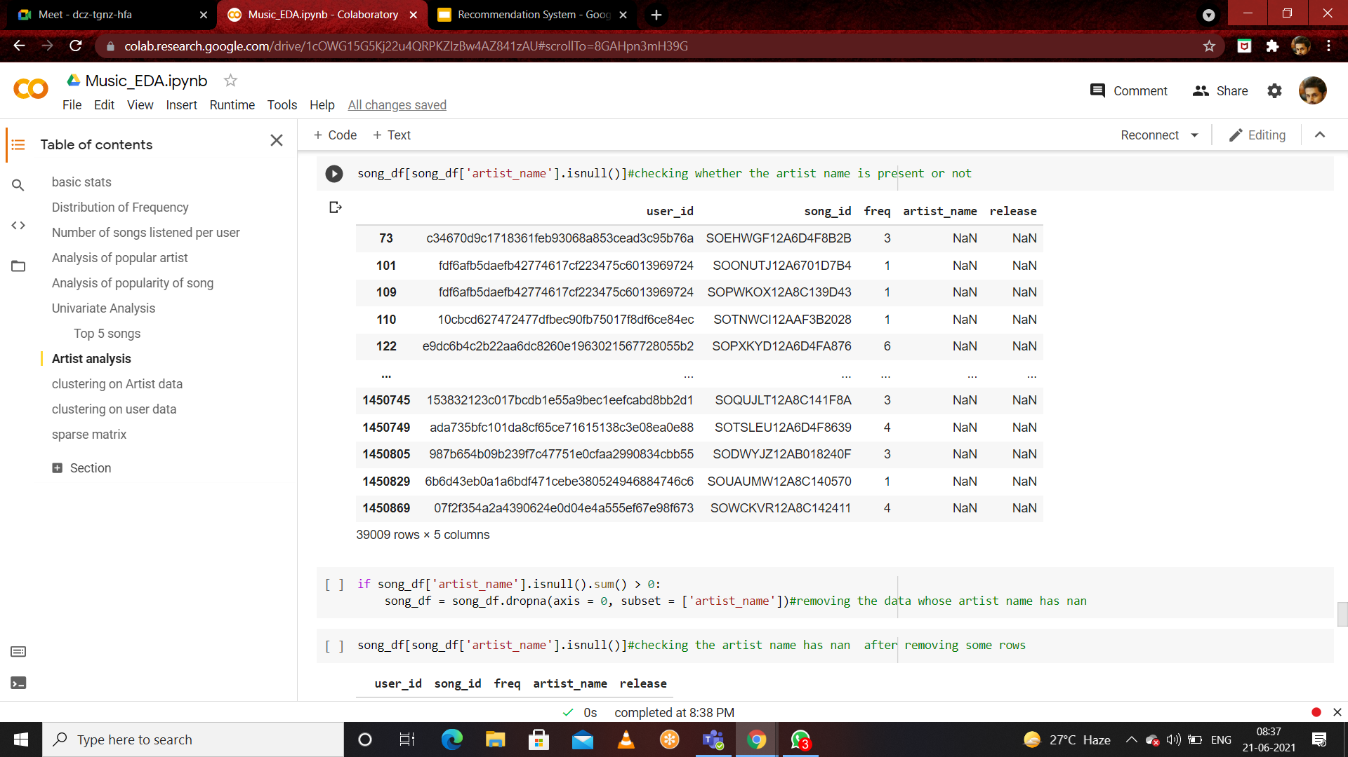

Slide 7
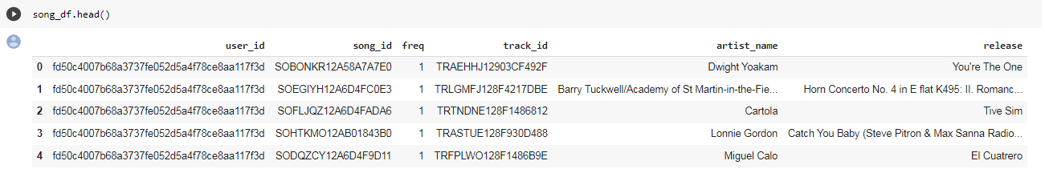


Music data shows how many times a subscriber listened to a song, as well as the details of the song.
The Length of the Data
We create subset of the dataset

Slide 8
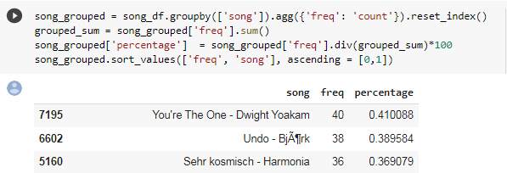


Analysis
The Most popular songs in data set
Second we have to count number of unique users in the data set
Third we have to count number of unique songs in the dataset

Slide 9
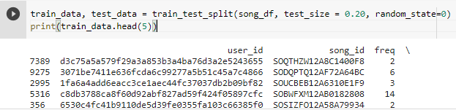
Training and Test Sets
Data set is already stratified
We use sklearn train test function to to extract 20% data in test set and 80% data in train set

Slide 10
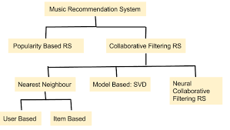
Algorithms or Methods we used
Popularity Based
Collaborative Filtering
Item Similarity Based
Content Based
SVD (Singular Value Decomposition)

Slide 11
Content Based Recommendation
Approach 1 -- Analysing the similarity between the items
Unlike Collaborative Filtering, if the items have sufficient descriptions, we avoid the “new item problem”
It is easy to make a more transparent system: we use the same content to explain the recommendations.
Approach 2 -- Building User Profile and Item Profile User Rated Content
Content-based method only have to analyze the items and user profile for recommendation.
Content-based method can tell you they recommend you the items based on what features.

Slide 12
Content Based Recommendation
Find total number of recommended song based on similarity score
Get song to find recommendation
Get number of songs most similar
Get number of songs to recommend

Slide 13
Popularity Based Recommendation
It is a type of recommendation system which works on the principle of popularity and or anything which is in trend
These systems check about the product or movie which are in trend or are most popular among the users and directly recommend those.
For example, if a product is often purchased by most people then the system will get to know that that product is most popular so for every new user who just signed it, the system will recommend that product to that user also and chances becomes high that the new user will also purchase that.

Slide 14
Popularity Based Recommendation
Merits of popularity based recommendation system
It does not suffer from problems like means on day 1 of the business also it can recommend products on various different filters.
There is no need for the user's historical data.
Demerits of popularity based recommendation system
Not personalized.They are not sensitive to the interests and tastes of a particular user.
The system would recommend the same sort of products/movies which are solely based upon popularity to every other user.

Slide 15
Popularity Based Recommendation
Get a count of user_ids for each unique song as recommendation score
Sort the songs based upon recommendation score
Generate a recommendation rank based upon score
Get the top n recommendations
We can use our popularity recommendation function to find the 10 artists recommendations

Slide 16
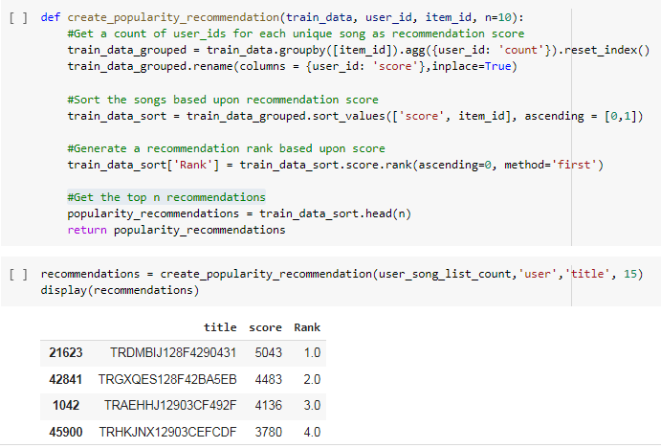
Popularity Based Recommendation

Slide 17
Collaborative filtering
Collaborative filtering is a method of making automatic predictions about the interests of a user by collecting preferences or taste information from many users .
Predictions made by collaborative filtering are personalized, but in this process of filtering for information or patterns involves collaboration among multiple users and their interests.
They are classified into
Item Based Similarity Recommendation
User Based Similarity Recommendation

Slide 18
Methods Used In Implementation
Songs that are often listened to by a unique user. These songs are more likely to be heard by another user in the future with similar interests.
Users who tend to listen to the same songs with a frequency in the past might have similar interests and will probably listen to the same genre / artist songs in future
Item based similarity doesn't imply that two things imply that two things are like each other in case of attributes, Rather, it is similarly concerning having Individuals treat that two given things in case of Like or dislike

Slide 19
Steps Involved in Item based recommender model
Get unique Songs corresponding to the user
Get unique users corresponding to the songs
Get unique items based on the training data
Constructing the co-occurrence matrix
Using the co-occurrence matrix to make some music recommendations

Slide 20
Co-Occurrence Matrix
Co-occurrence matrix transforms the history matrix into item-by-item based matrix recording with items appeared together in the users history.
Steps Involved in Constructing a co-occurrence matrix
Get users for all songs in user_songs.
The size of the matrix is the sum of all user_songs multiplied by the length of unique songs
Calculate similarity between user songs and all unique songs in the training data

Slide 21
Collaborative Recommendation
Item Similarity Based Recommendation
5,000 most popular songs represents 65.98% of total listen.
Recommend songs for the user using personalized model
No. of unique songs for the user: 3
no. of unique songs in the training set: 5000
Non zero values in cooccurence_matrix :1398
The top 1 and compare them to the two most played songs by this subscriber.

Slide 22
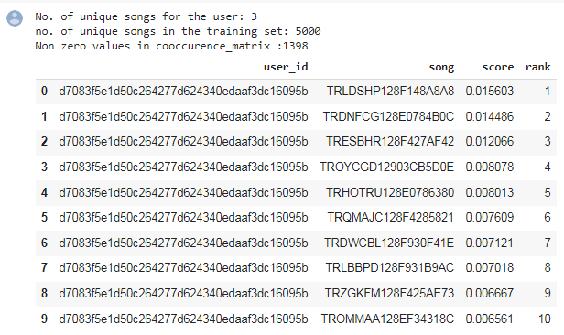
Collaborative Recommendation

Slide 23
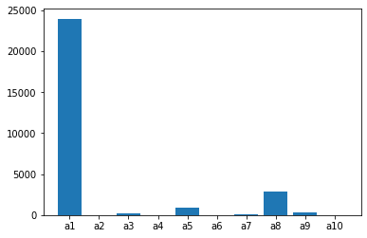
K-Means clustering
Clustering on Artist data

Slide 24
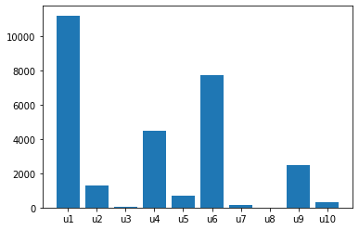
K-Means Clustering
Clustering on User data

Slide 25
Singular Value Decomposition(SVD)
Notes:
It de

Slide 26
Definition
SVD essentially reduces the dimension through latent factors extraction/recommender systems
It decomposes Original User Item matrix (A) into 3 matrices:
Matrix U - left orthogonal matrix which is related to User and latent factors
Matrix S - Diagonal factors which relates to the strength of latent factors
Matrix V - right orthogonal matrix which is related to Item and latent factors

Slide 27
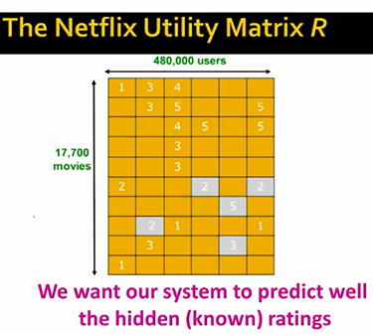
SVD - contd
Going back to our main goal of prediction of missing ratings – we essentially want a system which gives smallest RMSE – Root mean squared errors.
How do we approach the rating prediction? It would be through Martix factorisation. I.e we factorise our rating matrix of User/Movies into sub singular matrices by applying SVD
Fig 1: Below is Netflix Utility Matrix – where greyed out cells are known ratings but we try to predict using Latent factorisation:

Slide 28

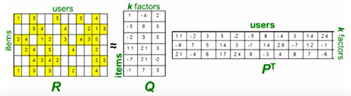
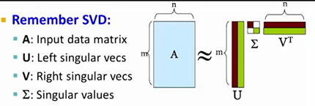
SVD - contd
What is latent factorisation?
We factorise our Rating matrix (R) into sub matrices Q & P^{T} , where dot product of Q & P^{T} would result into our Rating matrix
Our Rating Matrix
R = Q*P^{T}
Q will have 1 row per item (movies) and k factors (columns)
P will have 1 column per users and k factors
where k factors is < N (total users in our dataset)

Slide 29
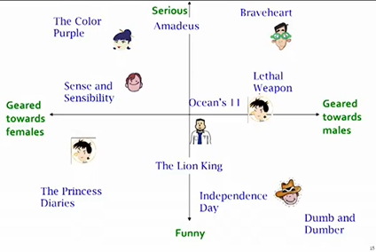
SVD - contd
So each point in Rating matrix R would correspond to a row and a column in the matrix Q & P. Essentially the factors can be considered as multiple axes in a multidimensional space with each user and movie corresponding to a point in this space.
Fig 3: Here k factors = 2, Serious/funny & Females/males – all movies and users occupy a position in this space.
Here the prediction is which users are closer to which movies?

Slide 30
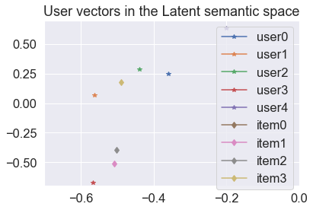

Slide 31
Conclusion
Once we have defined the focus entity, our greatest effort will be to prepare the data according to this entity and to meet the recommended recommendation algorithm.
The choice of the algorithm also passes through the information we have, but as we have seen, even with few characteristics, we can develop systems of recommendations of diverse complexity and with expressive results for the business.

Slide 32
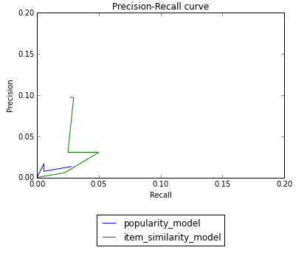
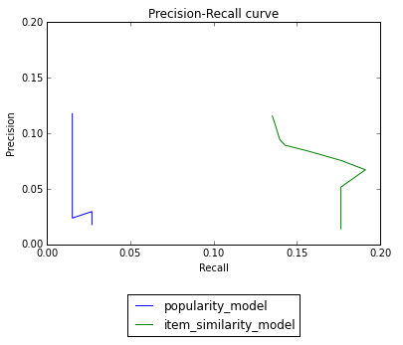
Evaluation [ Result & Analysis ]
Precision recall curves for a larger subset of data
Plotting precision recall curves for a larger subset
of data (100,000 rows)

